Slide 1
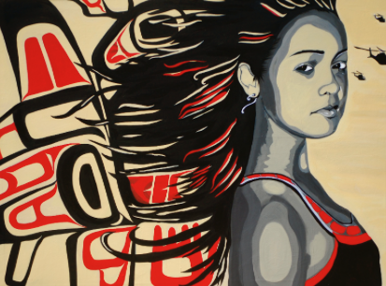
“We’re More Than Just Beads and Feathers” Producing Counter Culture against Common Portrayals of Aboriginal People
Jeanie wilson
ED6106

Slide 2
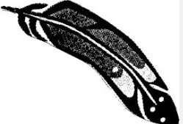
We’re more Than…
Author, Jason Eaglespeaker “wondered why spectators cheered for him when he was wearing his powwow outfit but showed him racism in daily life. This phenomenon is what the novelist Thomas King has referred to as “half-time entertainment”: when we’re dancing and singing, we’re always popular. When we’re reminding people about the history and continuing effects of colonialism – what some people refer to as “complaining” – our popularity takes a nosedive. Reality check: creating awareness and understanding is about more than the additive markers of “cultural diversity” – it’s about deconstructing assumptions, biases, and dominant frames of reference” (Dragonfly, 2014)
Notes:
Retrieved from http://dragonflycanada.ca/more-than-just-beads-and-feathers/

Slide 3
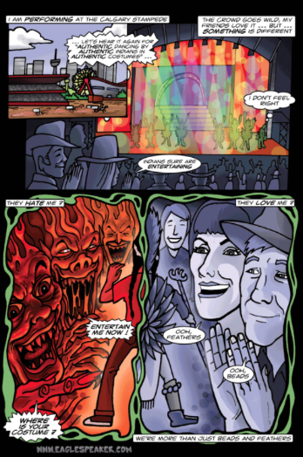
Challenging the Dominant Discourse
“Instantiated by means of practices such as language use, traditions of family and culture, and institutions such as school and media, we can understand discourses as having different degrees of authority, with dominant discourses appearing natural or true, denying their own partiality, and supporting and perpetuating existing power relations” (McKenzie, 2006, p.200)

Slide 4
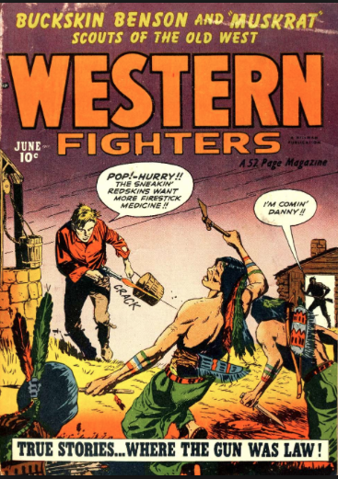
Sociocultural Politics
“An analysis of oppressive features of popular culture and the ideologies and belief systems supported by them” (Kelly, 2012, Introductory Notes)

Slide 5
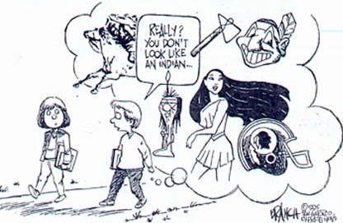
Sociocultural Politics
“A genocide occurred and the [American] culture wanted to perpetrate the idea that [the natives] these people are now mythologic, you know, they don’t even really exist, they’re like dinosaurs.” - Jim Jarmusch, 2012
Notes:
Retrieved from http://www.reelinjunthemovie.com/site/the-film/
Image retrieved from http://www.bluecorncomics.com/stharm.htm

Slide 6
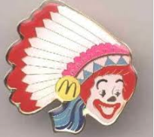
Obscurity
“It has been said many times that stereotypes may yet carry within them some wisp of truth, but they do more to obscure the clarity of the larger reality of Native American and indigenous culture as a diverse, powerful and important expression of human life.” Ukumbwa Sauti, M.Ed.
Reelism in Native American and Indigenous Portrayals
Notes:
Quote retrieved from http://www.reelinjunthemovie.com/site/blog/
Image retrieved from http://www.bluecorncomics.com/mascots.htm

Slide 7
(Mis)Representation
“I have said it before and I will say it again: Western societies that are largely based upon colonial attitudes (and white privilege) seem to only ‘make space’ for Native-Americans (or Canadians, for that matter) when their culture is romanticized enough to be put on display (e.g. for hungry Twilight fans).”
- Malory Beazley, 2010
Notes:
Retrieved from http://twimedia.blogspot.ca/2010/03/issue-of-native-misrepresentation-in.html

Slide 8
Dismissive
“I’m not being sarcastic. Native history in North America as writ has never really been about Native people. It’s been about Whites and their needs and desires. What Native peoples wanted has never been a vital concern, has never been a political or social priority.”
- Thomas King (2012)
Notes:
King, Thomas (2012). An Inconvenient Indian: A Curious Account of Native People in North America. Doubleday Canada: Toronto.

Slide 9
Stereotypes in Media
“Portrayals of Aboriginal people as being primitive, violent and devious, or passive and submissive, have become widespread in movies and TV programs and in literature ranging from books to comic strips. Such depictions have become a comfortable frame of reference for most of us each time there is a question about Aboriginal people, even though very few non-Natives have had the opportunity to meet a Native person in real life. Even if old Westerns rarely took place in Canada, the stereotypes they conveyed crossed borders.” – Media Smarts
Notes:
Retrieved from http://mediasmarts.ca/diversity-media/aboriginal-people/common-portrayals-aboriginal-people

Slide 10
The Indian Princess
“The Indian Princess is the Native beauty who is sympathetic enough to the white man's quest to be lured away from her group to marry into his culture and further his mission to civilize her people. "The Indian princess is strictly a European concept," writes Native American Joseph Riverwind. "The nations of this country never had a concept of royalty. We do not have kings, queens or princesses.” Media Smarts (2012)
Notes:
Retrieved from http://mediasmarts.ca/diversity-media/aboriginal-people/common-portrayals-aboriginal-people
Image retrieved from http://disney.wikia.com/wiki/Pocahontas_(character)

Slide 11
Counter Culture
“None of these women, said Valaskakis, remotely resembled the "powerful, competent, articulate" women she grew up with on her reserve in Wisconsin. However, the media image of the Indian princess is challenged through some Aboriginal cultural events like powwows where young women are elected as princess of the powwow because of their attachment to traditional values of respect, sharing and solidarity. This image of the princess does not reflect a romanced and stereotyped image, but rather a desire to reverse the trend: for a long time, the model of youth has been about self-destruction, vandalism and drug and alcohol consumption. Today, the models have changed and someone is honoured for his or her achievement, successes and commitment in defending the values of his or her group.” Media Smarts
Inez Jasper, Sto:lo Singer&Songwriter
Notes:
Retrieved from http://mediasmarts.ca/diversity-media/aboriginal-people/common-portrayals-aboriginal-people
Image retrieved from https://myspace.com/btgirlscalendar/photos

Slide 12
The noble savage
“There’s a danger in supporting this myth – the danger is this idealized image can constrain us to the idea that we are nothing more than a simple people, trapped in time. This is a romanticized image of the highest form of Indian there is = the zenith of Aboriginal existence. I mean, Ninjas and Samurai are cool too, but in Japan they don’t actually run around in black pajamas, pulling out throwing stars every two seconds – they’ve moved on and so have we.”
- Steve Keewatin Sanderson, Author of Rising Above, Graphic Novel
Notes:
Sanderson, Steve Keewatin (2012). Rising Above. iLit English Resource. McGraw-Hill Ryerson, Toronto.

Slide 13
Counter Culture A Study of Indian-Ness
“In 1999 the Indian figure had knelt at the base of the Samuel de Champlain monument was released from duty, following a protest held at the site by the Assembly of First Nations. The AFN argued that the Indian figure did not represent the contributions that Aboriginal people have made to the development of Canada. They also noted that he was inappropriately dressed--it was not historically accurate. After several years of discussion with the National Capital Commission, both groups agreed to move him across the street to what turned out to be an obscure part of Major's Hill Park. With no formal plans for redevelopment the vacant plinth that the Indian Scout used to occupy, I began inviting friends to the site for a portrait sitting.” – Jeff Thomas, Scouting for Indians
Indian Man from Nepean Point
Jeff Thomas, 1992
Notes:
Retrieved from http://www.scoutingforindians.com/

Slide 14
Counter Culture
Notes:
Reel Injun Movie Trailer

Slide 15
Concluding Thoughts
“Popular culture contains a plurality of meanings that enable actors ‘to partake of both of its forces simultaneously and devolves to them the power to situate themselves within this play of forces at the point that meets their particular cultural interests” (Lashua, 2006, p.395)
Notes:
Retrieved from http://mediasmarts.ca/diversity-media/aboriginal-people/common-portrayals-aboriginal-people

Slide 16
Concluding Thoughts
“hooks (1994) stressed that ‘talking critically about popular culture [is] a powerful way to share knowledge, in and outside the academy, across differences, in an oppositional way’. These small victories inform larger hegemonic processes of social change, cultural hybridity, and border crossings, where young people make and remake popular culture into meaningful aspects of their everyday lives” (Lashua, 2006, p.406).

Slide 17
So much more then beads and Feathers…
Notes:
Joey Stylez “Indian Outlaw” Top 40 Rap song

Slide 18
References
Beazly, Malory (2010). Issues of Native Misrepresentation. Retrieved from http://twimedia.blogspot.ca/2010/03/issue-of-native-misrepresentation-in.html
Comic Images retrieved from http://www.bluecorncomics.com/stharm.htm
Dragonfly retrieved from http://dragonflycanada.ca/more-than-just-beads-and-feathers/
Lahua, B. (2006). “Just another native?” Soundscapes, chorasters, and borderlands in Edmonton, Alberta, Canada. Cultural Studies ↔ Critical Methodologies, 6(3), 391- 410. (e-reserve) http://csc.sagepub.com/content/6/3/391.short
McKenzie, M. (2006). Three portraits of resistance: The (un)making of Canadian students. Canadian Journal of Education, 29(1), 199-222. (e-reserve) http://www.csse-scee.ca/CJE/Articles/FullText/CJE29-1/CJE29-1-mckenzie.pdf
Media Smarts(2012). Common Portrayals of Aboriginal People. Retrieved from http://mediasmarts.ca/diversity-media/aboriginal-people/common-portrayals-aboriginal-people

Slide 19
References
Kelly, Ursula (2012). Introductory Notes. ED6106: Popular Culture and Literacy Education. Memorial University of Newfoundland.
King, Thomas (2012). An Inconvenient Indian: A Curious Account of Native People in North America. Doubleday Canada: Toronto.
Reel Injun retrieved from http://www.reelinjunthemovie.com/site/the-film/
Sanderson, Steve Keewatin (2012). Rising Above. iLit English Resource. McGraw-Hill Ryerson, Toronto.
Stylez, Joey (2009). Indian Outlaw The Black Star. Stressed Street.
Thomas, Jeffrey (2010). Scouting for Indians. Retrieved from http://www.scoutingforindians.com/
Ukumbwa Sauti (2012).Reelism in Native American and Indigenous Portrayals. Retrieved from http://www.reelinjunthemovie.com/site/blog/

